Slide 1

Property Price Prediction
Guidance By:
Mrs.Shweta bedarkar
Submitted By:
Rukmini Diddi
Pratiksha Jagtap

Slide 2
PROBLEM STATEMENT
Prices of real estate properties are sophisticatedly linked with our economy .
Despite this , we do not have accurate measures of house prices based on the vast amount of data available .
Proper and justified prices of properties can bring in a lot of transparency and trust back to the real estate industry , which is very important for most consumers.

Slide 3
Data source and Variables
Data source provided by mentor- “Property price train and test”
Variables:
- 79 variables present in the dataset.
variable named “SalePrice”.
Dependent variable.
Represent final price at which the home was sold.
Remaining 78 variables
Represent different attributes of the house like Building_Class', 'Road_Type', 'Lane_Type', 'Property_Shape', 'Land_Outline,etc.

Slide 4
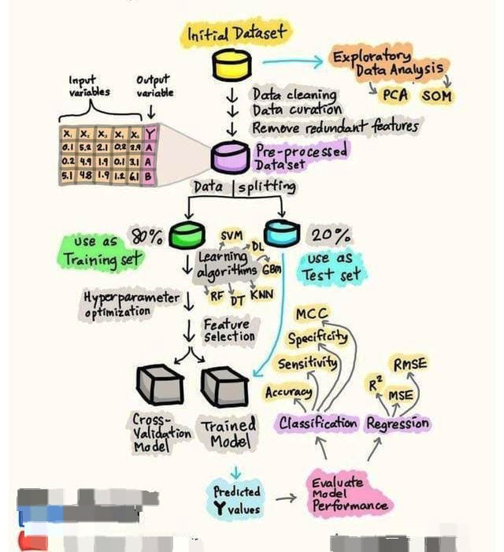
Flow

Slide 5
EDA &VISULATION
Exploratory data analysis is an approach to analyzing data sets to summarize their main characteristics, often with visual methods.
By doing this you can get to know whether the selected features are good enough to model, are all the features required, are there any correlations based on which we can either go back to the Data Pre-processing step or move on to modeling.
Once Exploratory Data Analysis is complete and insights are drawn, its feature can be used for supervised and unsupervised machine learning modeling

Slide 6
What Are The Steps In Exploratory Data Analysis In Python?
Description of data
Handling missing data
Drop NULL or missing values
Fill Missing Values
Predict Missing values with an ML Algorithm
Handling outliers
Understanding relationships and new insights through plots

Slide 7
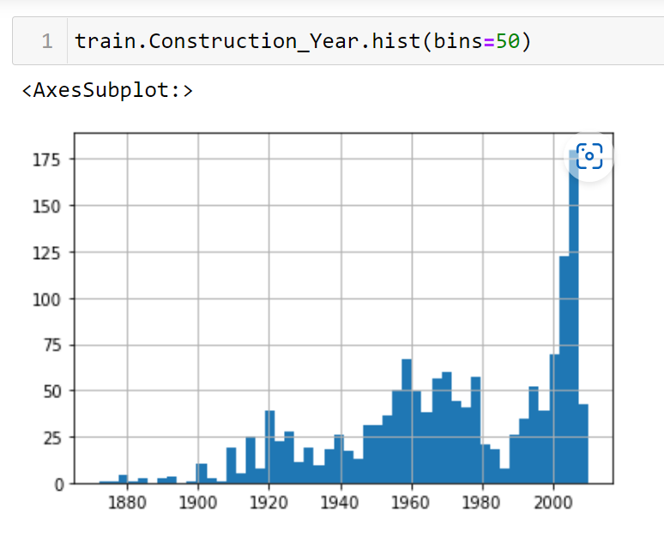
Understanding relationships and new insights through plots
We can get many relations in our data by visualizing our dataset. Let’s go through some techniques in order to see the insights.
Histogram.

Slide 8
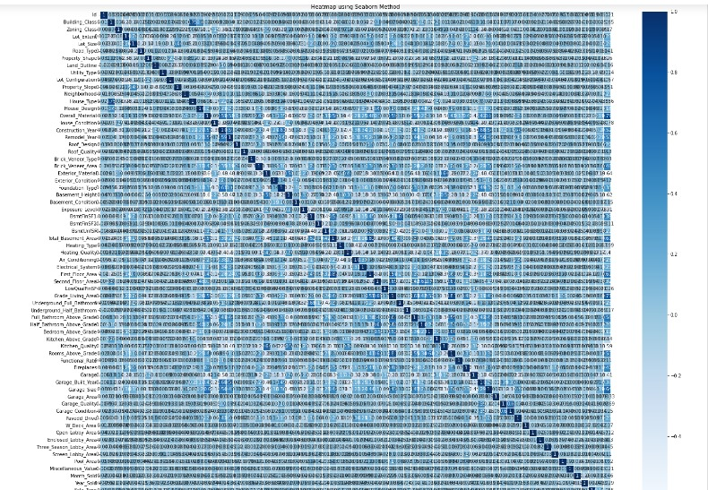
Heatmap

Slide 9
ALGORITHMS:
Regression is the process of predicting a continuous value.
In regression there are two types of variables: a dependent variable and independent variables.
Regression is based on the nature of relationship between independent and dependent variables.
We used multiple linear regression. Multiple linear regression is When more than one independent variable is used to estimate dependent variable.
In this project dependent variable is SalePrice and independent variables are house type,area,Lotsize and many more parameters.

Slide 10
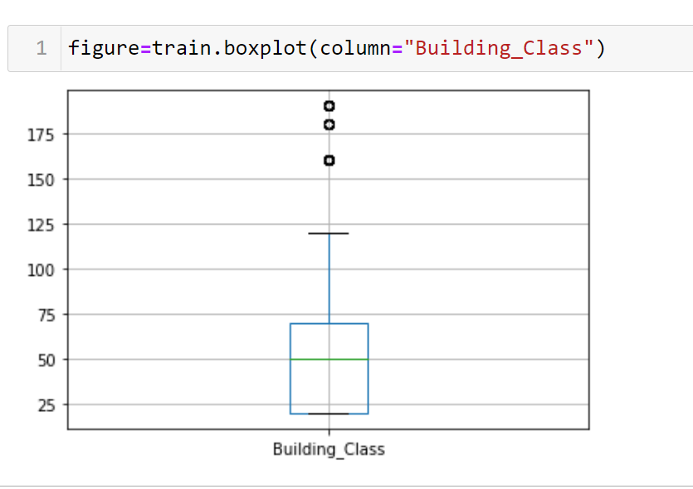

Slide 11
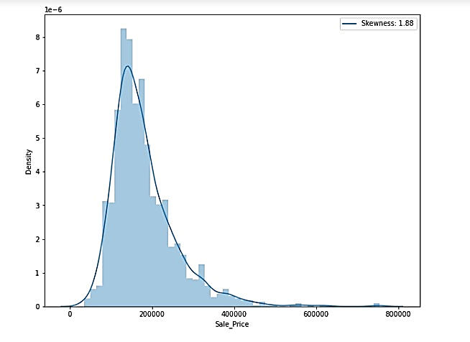
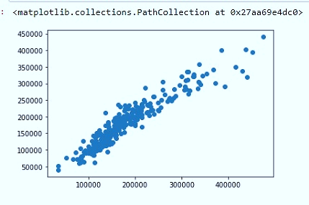
PREDICTION

Slide 12
Model
Model Name
linear
0.842015
0.834405
lasso
0.843725
0.836197
R^2
Adj
R^2

